Slide 1
NBA Analysis - Project 2
Awe, Dan, Garrett, and Nick

Slide 2

We chose a dataset that consists of various NBA statistics from the 2019-20 season.
This dataset will allow us to show our in depth analysis in an interactive dashboard.
We decided to work with this dataset because it was the most comprehensive and current one available.
Link to data set

Slide 3
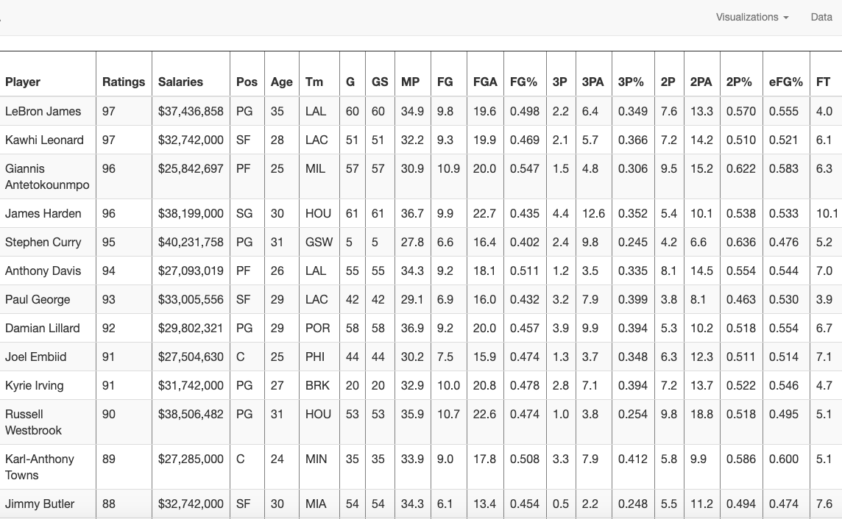
Cleaning Process
In order to get the necessary data from our csv file we used a combination of Python, Postgres, and SQL to clean and calculate necessary values and data points we needed for our various JavaScript charts.

Slide 4

Dynamic Scatter Plot comparing NBA player per game statistics

Slide 5
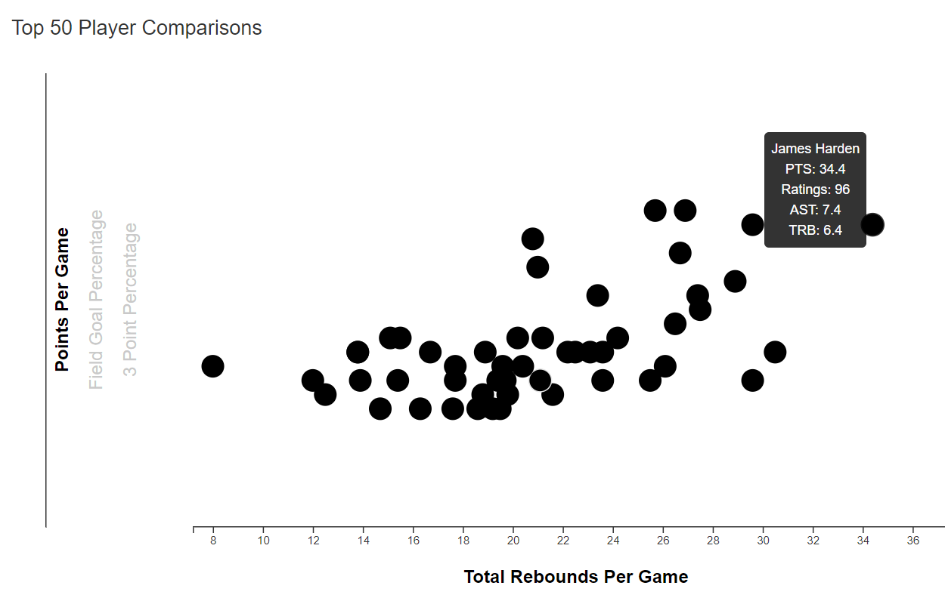
Dynamic Scatter Chart
Chart comparing the top 50 rated NBA players from the 2019/20 season
Comparing player performance per game in:
Points
Rebounds
Assists
Comparing player efficiency per game in:
Field goal %
3 point %
# of 3 pointers
Why this chart?
Easily compare player statistics with various variables in pleasing visualization

Slide 6
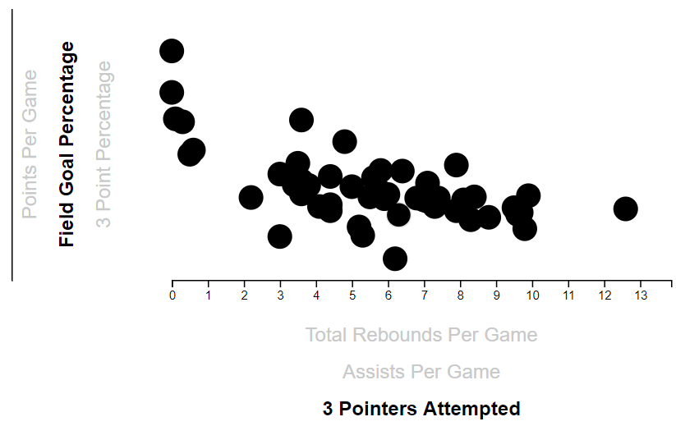
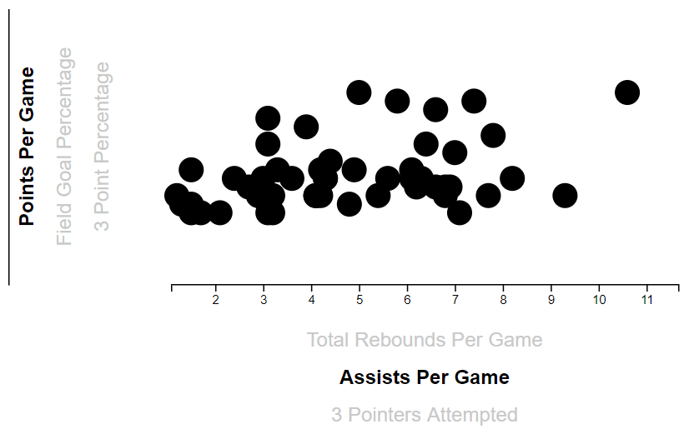
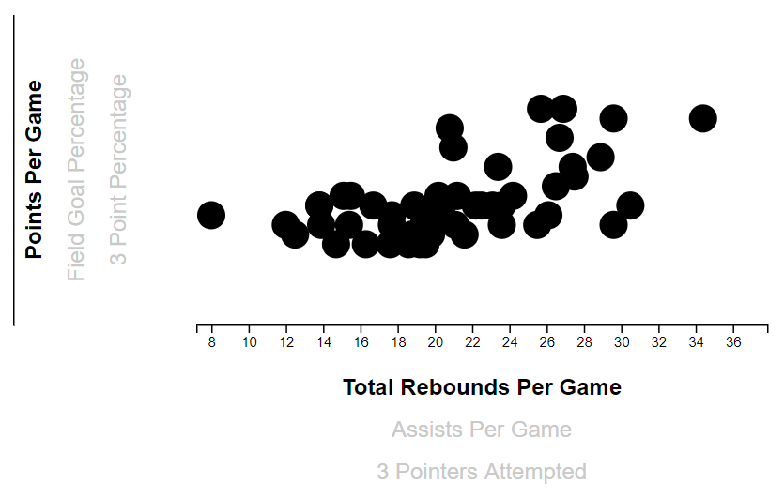
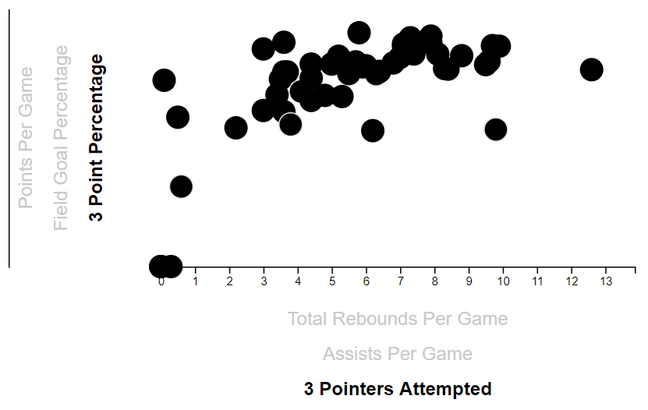

Slide 7






MVP Race!

Slide 8
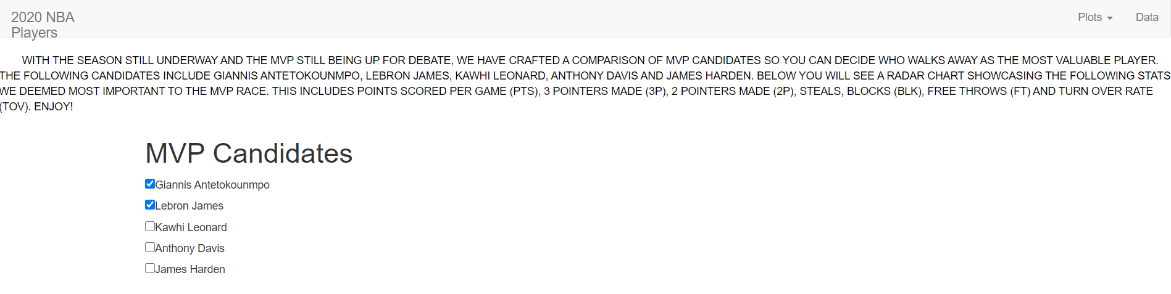
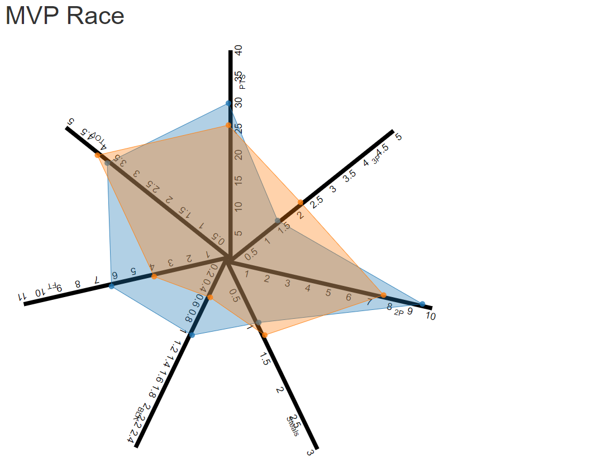
Initial goal was to create a chart cycling through our csv to compare players with side by side radar charts and a drop down menu to pick any of the available players in our data.
Motivation behind this particular chart was to imitate how players skill sets are shown in games.
Versatile chart (Can compare multiple types of stats).

Slide 9
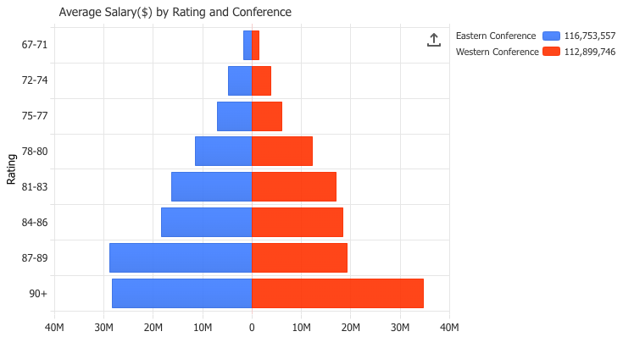
Average Salary by Ratings Group
- We used a populations pyramid JavaScript chart to take a look at the average salaries of NBA players based on similar ratings
- The coding aspect that stood out most was having one set of data points negative along the y-axis in order to ensure that the charts displayed side by side

Slide 10
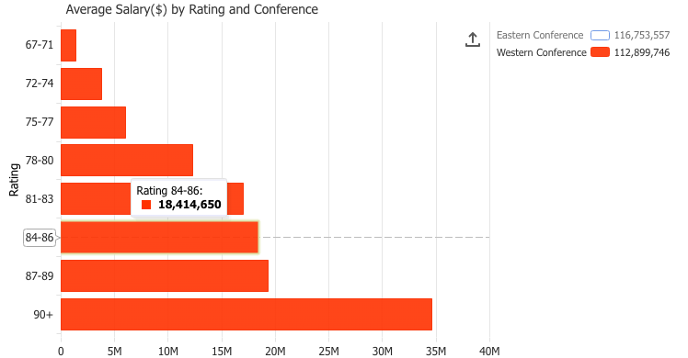
Salaries by Ratings Conference View
- With this legend we gave the chart some interactiveness in order to switch between conferences and also to be able to hover over the chart itself and look at the average salaries by ratings group
-This new JavaScript populations chart normally meant for looking at populations for gender gave us great insight to how NBA teams salaries look like based on player rating.

Slide 11
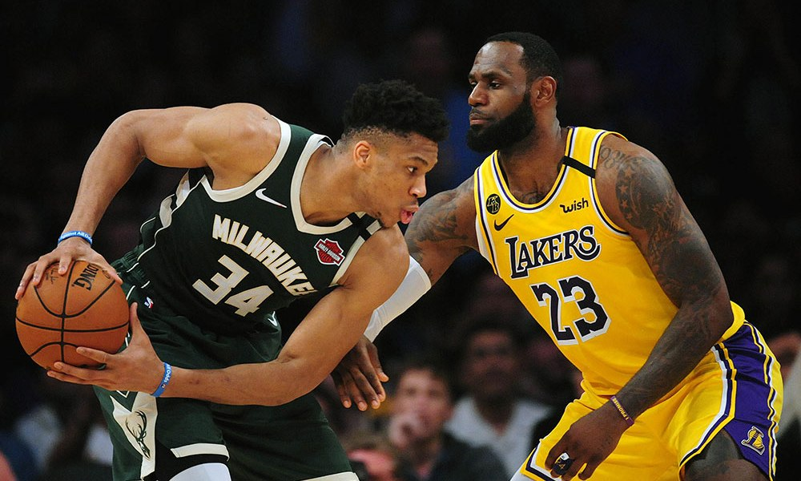
The median player salary based on rating

Slide 12
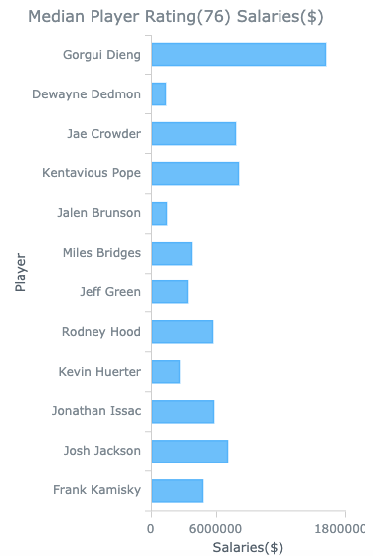
Median Salary
Took a sample size of 12 of the median ranked players in the NBA then compared their salaries
All players to my surprise were rated 76- however varied in salary greatly

Slide 13
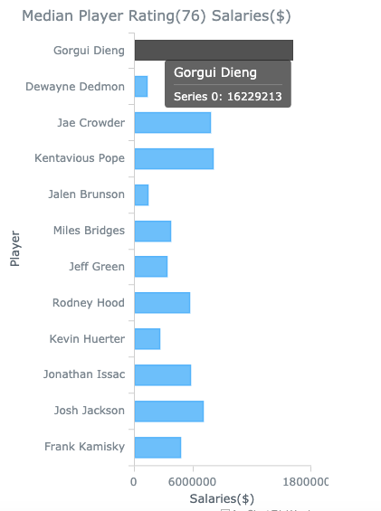
Interactivity
Added interactivity of hovering over each player in order to show the exact salary of each player and display their individuals names as well.

Slide 14

Challenges:
-Flask implementation
-Multiple d3 scripts
-Remaking chart due to d3 errors

Slide 15

Web build - https://theriotn95.github.io/Project_2/index.html

Slide 16
Q&A

